Slide 1

Smart Living
Using Technology Enabled Supports
To Improve Outcomes

Slide 2
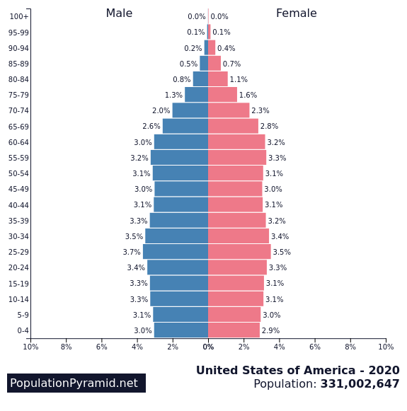
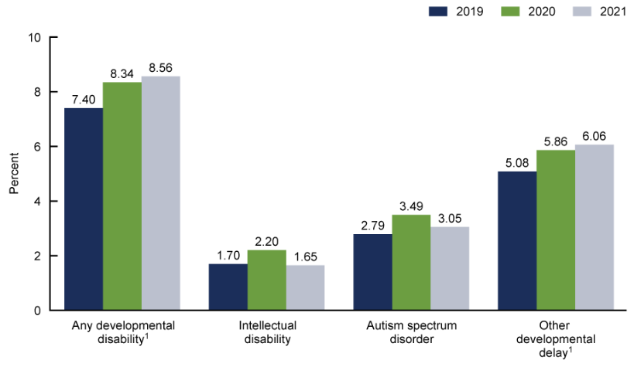
Why are we meeting today?
More and more people with disabilities need support with a shrinking workforce

Slide 3
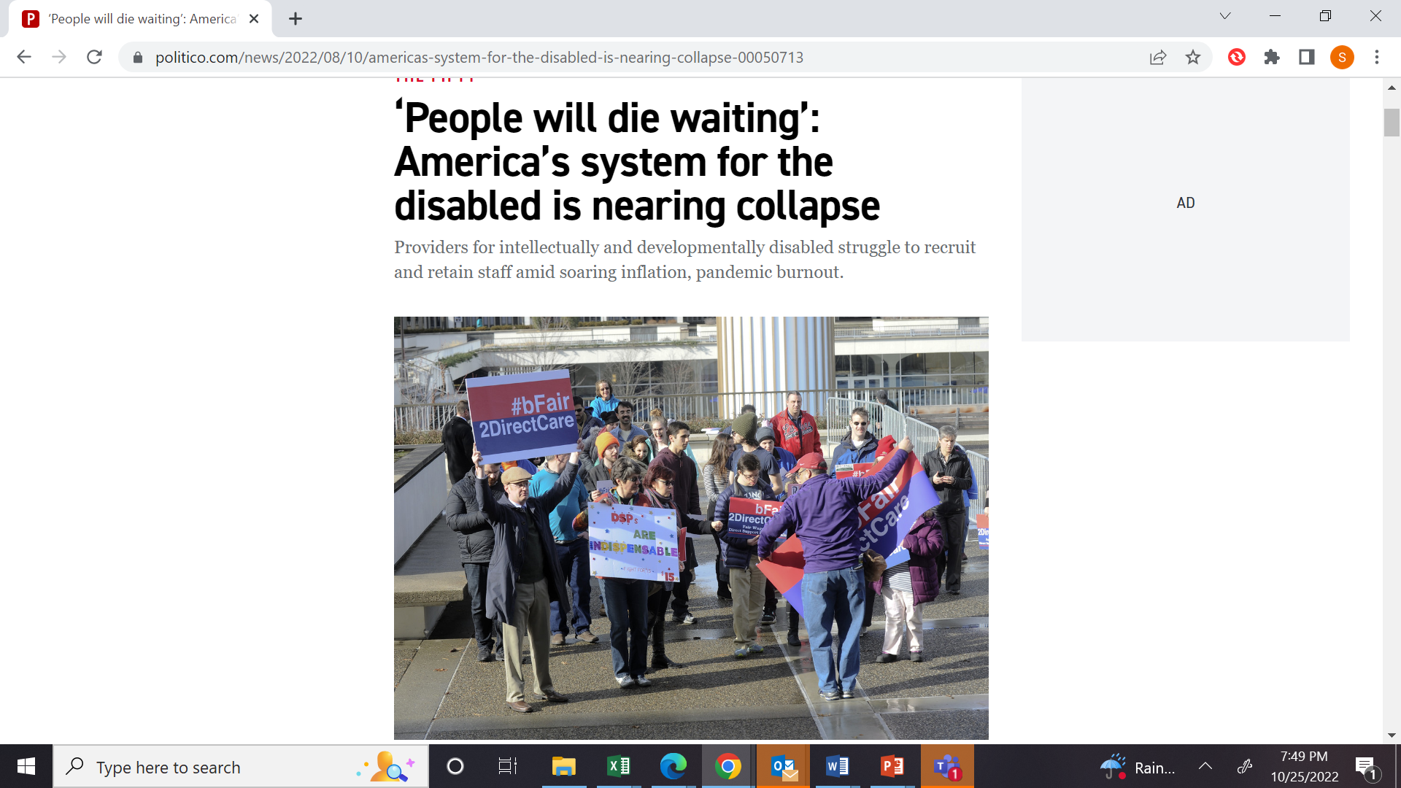
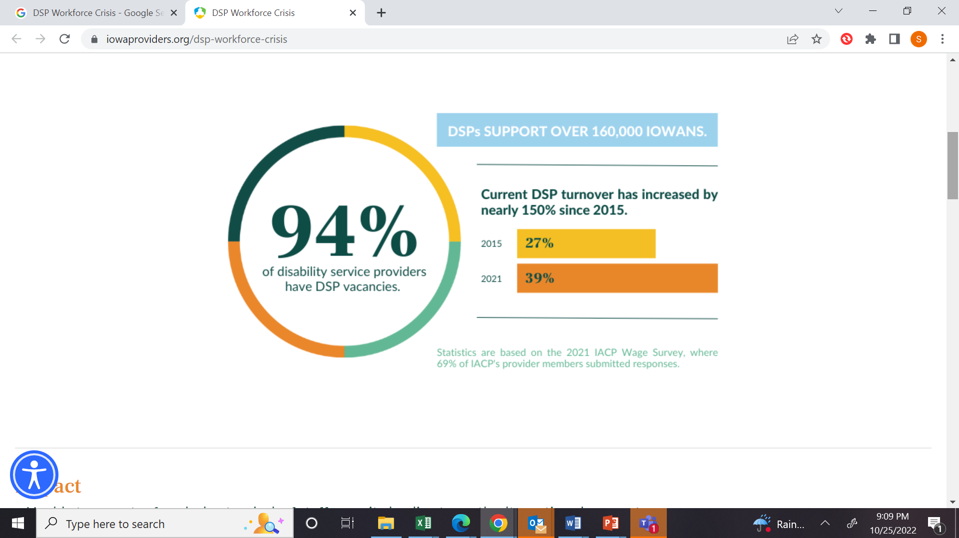
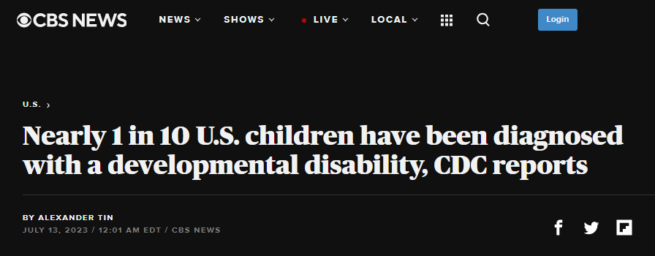
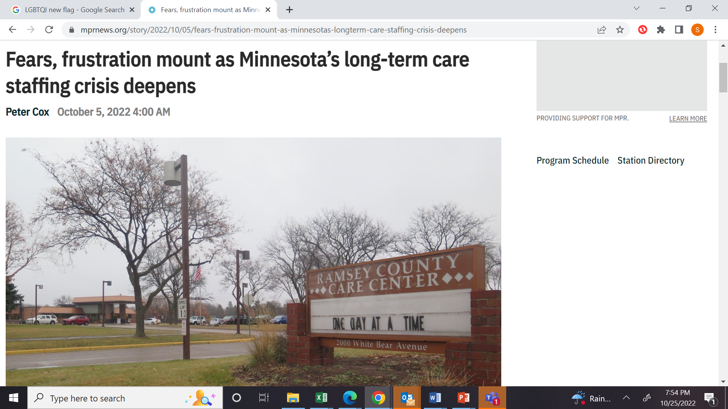
And the problem is only getting worse

Slide 4
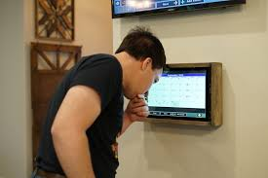
What is Smart Living Remote Supports?
  Remote Supports is a service model that combines technology and direct care to support people with developmental disabilities. It uses two-way communication in real time, including home-based sensors, cameras and other devices, to provide a less invasive way of responding to the needs of individuals living in the community 24 hours a day, seven days a week.
  When hands-on care is not necessary, Remote Support makes it possible for direct care staff to provide care from a remote location, supporting a person's need for greater independence.
What is not Smart Living Remote Supports?
  Remote Supports is not just a monitoring system by an outside dispatch company. Staff are the same as the in-person staff who are trained and know the individuals they support. Remote Support Professionals are, in most cases, able to provide the same level of support to someone using technology as the would in the home.

Slide 5
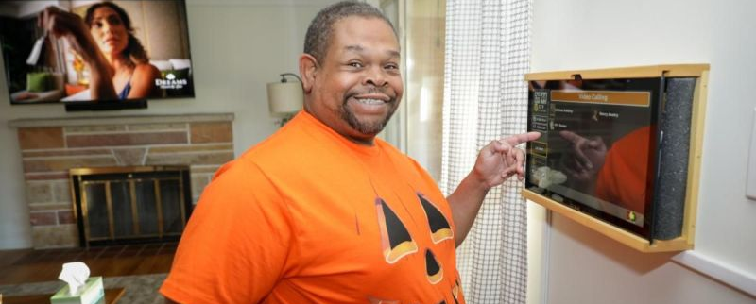
Meet Don

Slide 6
Some Frequently Asked Questions
  How are individuals determined to be part of the program
  How does this change the current services
  Does this mean people will no longer have in person staff
  What happens when power/internet go down
  What is the timeline for my individual I support

Slide 7
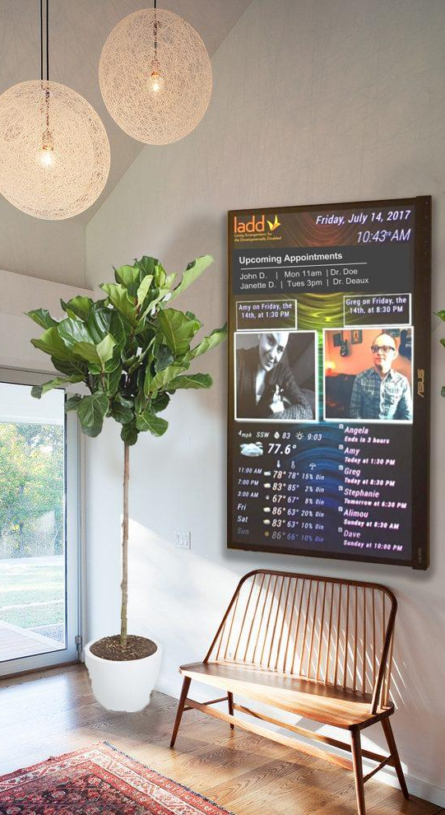
Remote Support Successes and Outcomes
Published research on what technology investments have the greatest ROI and/or impact on independence
A means for remote supports once a person leaves their home developed alongside service specific apps
An alternative service model for people that do not need or want a typical in person staffing model
Significant cost savings and increased independence
9
7

Slide 8
A Person-Centered Experience
  ASSESSMENT
  Assessment begins at the highest level and then works down granularly until we know what the persons needs and items that are important to and for them
TEAM MEETING, PROPOSAL OUTLINED TO ALL INVOLVED
Meeting held with individuals' team to go over remote plan, review technology and understand remote plan
  TECHNOLOGY DETERMINATION
  Tech team matches items identified with available and appropriate technology based on the individual’s needs
TRAINING PERIOD
Technology is installed, and training period begins with in-person staff still in home and remote support staff overlapping
  IN-PERSON NEEDS DETERMINED
  Items not solved with technology delivered through Integrated Targeted Supports
STAFF FADE OUT
If training period is successful and all data proves to be correct, then in-person staff are faded out and remote beings
  REMOTE PLAN DEVELOPED
  With the information for person’s assessment, staff time study and tech determination a remote plan is determined
FUTURE PLANNING
As a person’s needs change either technology is changed or in-person staffing times can change
8
8

Slide 9






SAMPLE INDIVIDUAL’S SUPPORT NEEDS
  COMMUNICATION
  6 must have requirements relating to simple, voice, video & staff assistance
  HOME MONITORING
  14 must have requirements relating to detecting & monitoring activity within
  & around the home
  SMART HEALTH
  3 must have requirements relating to monitoring and measuring health metrics
DAILY ROUTINES
16 must have requirements relating to recurring tasks, calendars, reminders & messages for residents
EXTERNAL MONITORING
2 must have requirements relating to monitoring & assisting activity outside
the home
HOME AUTOMATION
15 must have requirements relating to in-home technology assistance & accessibility

Slide 10

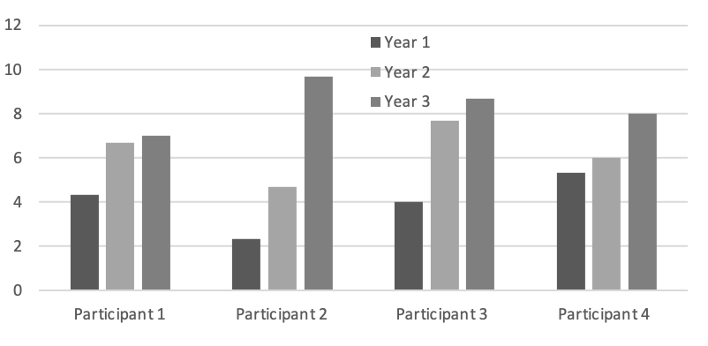
PROOF OF CONCEPT
3 year qualitative and quantitative studies completed by Xavier University on this model of service delivery
Published research on what technology investments have the greatest ROI and/or impact on independence shows success of services in both ROI and in level of independence for the people served
A reduction in open positions for direct support professionals from 21% to less than 3% with a direct reduction in overtime, burnout and personnel costs
3-year Study Results:
Increase in levels of independence

Slide 11
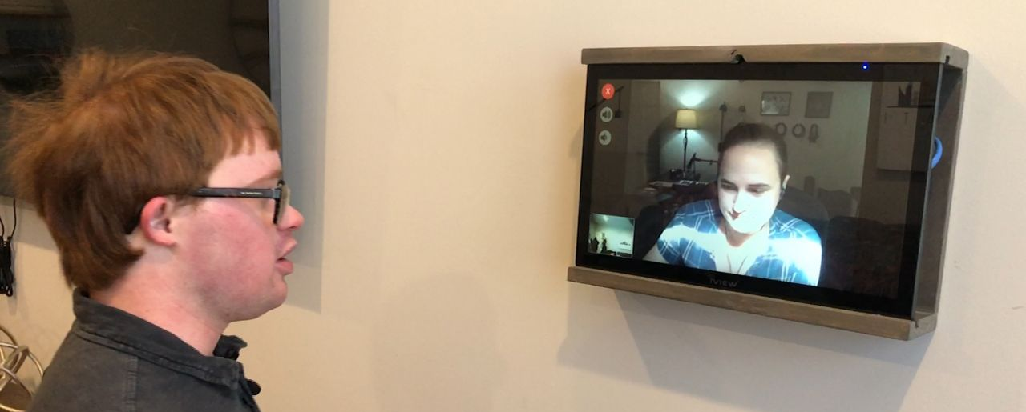
Questions?

Slide 12
THANK YOU
Brian Hart
ShiftAbility/Smart Living Systems
Chief Executive Officer
brian@shiftabilityconsult.com

